Slide 1
03 Professional Transformation
Rise of Emerging Industries
Demand for Cross-disciplinary Skills
Career Transition
Notes:
3. 職業轉型：新興行業的崛起與跨學科技能的需求
隨著一些傳統職業減少，新興行業的需求逐漸崛起。我們將研究這些新興職業，強調跨學科技能的重要性，並討論如何實現職業轉型。

Slide 2

Rise of Emerging Industries & Occupations
Job Creation Along with the development of Al, new jobs and opportunities will be created .
What kind of Roles will be needed?
Al Development: NLP Engineer, ML Engineer.
AI Maintenance: System Administrator, Product Manager.
Data Analysis: Business Intelligence Analyst.
Systems Oversight: Ethics Expert, Compliance Analyst.
(More Detail, See next slide)
Notes:
新興職業／新興行業的崛起
Job Creation: On the flip side, the development and implementation of Al can create new job opportunities. These may include roles related to Al development, maintenance, data analysis, and oversight of Al systems.
AI creating new job opportunities: ML Engineer, Data Scientist, Deep Learning Engineer, Computer Vision Engineer, NLP Engineer.

Slide 3
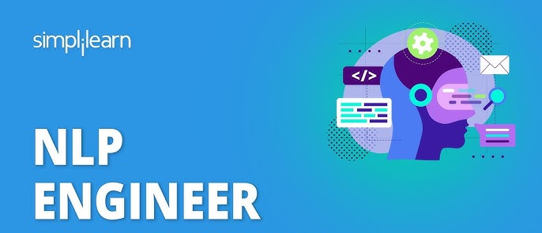
Rise of Emerging Industries & Occupations
< Example & Job Description of New AI Roles >
AI Development
AI Engineer:
Focuses on developing and implementing AI models, including designing, building, and optimizing neural networks.
NLP Engineer:
Focuses on AI systems that process and understand human language, such as speech recognition and text analysis.
Recruiting Company: Microsoft, Apple, Amazon.
For more detail, click the icon. →
Notes:
新興職業／新興行業的崛起

Slide 4
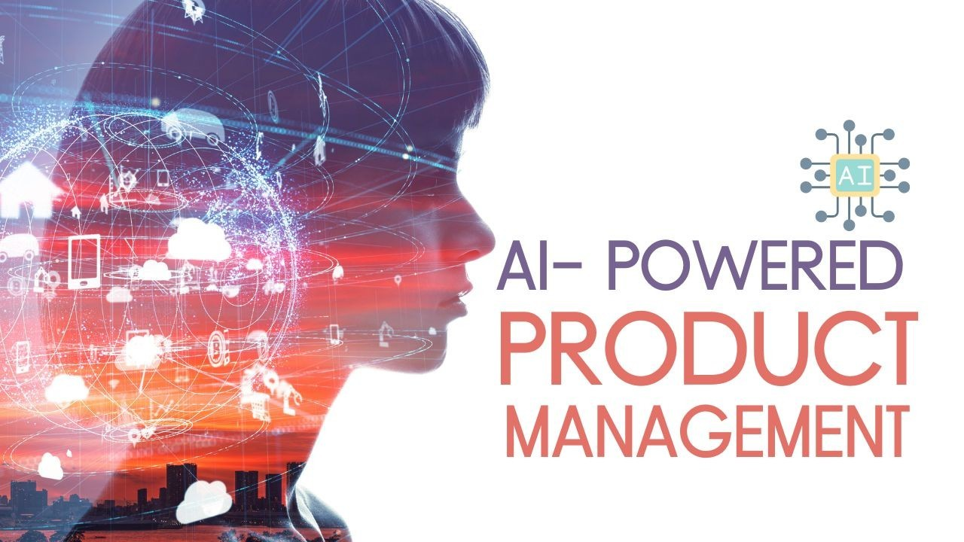
Rise of Emerging Industries & Occupations
< Example & Job Description of New AI Roles >
AI Maintenance
Systems Administrator:
Responsible for monitoring and maintaining operational AI systems to ensure the stability and efficiency.
Product Manager:
Manages the lifecycle of AI products, including planning, defining requirements, and coordinating cross-functional teams.
Enhancing decision-making, improving customer experiences and streamlining workflows.
For more detail, click the icon. →
Notes:
新興職業／新興行業的崛起

Slide 5
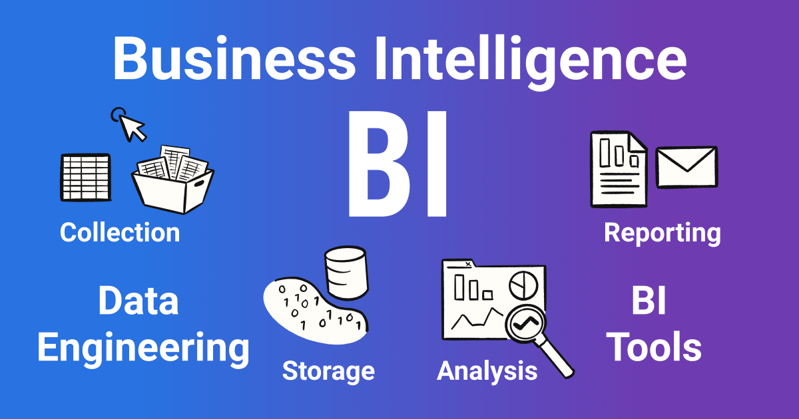
Rise of Emerging Industries & Occupations
< Example & Job Description of New AI Roles >
Data Analysis
Business Intelligence Analyst:
Business intelligence is the process of surfacing and analyzing data in an organization to make informed business decisions.
Analyst focuses on using data analysis to drive business decision-making and strategy formulation.
Data Engineer:
Responsible for building and managing data processing systems to support data analysis and ML activities.
↑For more detail, click the icon.
Notes:
新興職業／新興行業的崛起

Slide 6
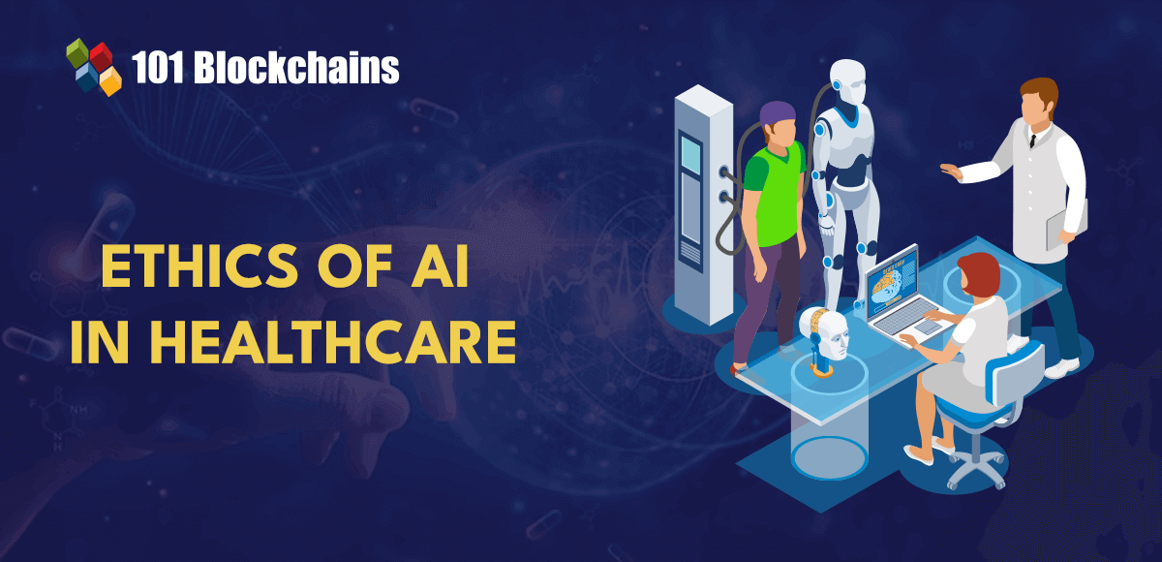
Rise of Emerging Industries & Occupations
< Example & Job Description of New AI Roles >
Systems Oversight
Ethics Expert:
Ensures that the development and use of AI systems adhere to ethical standards and legal norms.
The growing popularity of the use cases of artificial intelligence has created concerns regarding ethics.
It is important to identify the values and principles for ethical AI, as artificial intelligence would directly affect human lives.
Compliance Analyst:
Focuses on ensuring AI systems comply with industry standards and regulatory requirements, particularly in data privacy and security.
Notes:
新興職業／新興行業的崛起

Slide 7
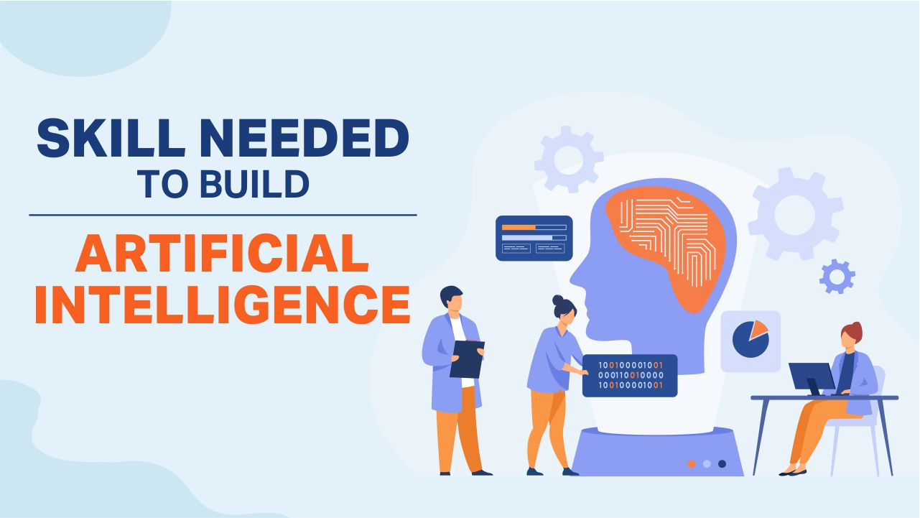
Demand for Cross-disciplinary Skills
Skill Shift Upskilling and reskilling programs become crucial for the workforce to adapt to the evolving job landscape.
What skills may be needed?
Programming & Software Development:
Familiar with at least one programming language (such as Python or C++) and understand the basic principles of software development.
Data Processing & Data Engineering:
AI systems heavily rely on data.
Strong data science skills (data cleaning, data transformation, and data storage techniques) are vital for AI development.
Notes:
跨學科技能的需求／強調跨學科技能的重要性
Skill Shift: The demand for certain skills may change. There is an increasing need for skills related to Al, such as programming, data science, and machine learning. Upskilling and reskilling programs become crucial for the workforce to adapt to the evolving job landscape.
Human-Al Collaboration
Augmented Creativity: Explore the idea that Al can serve as a tool to augment human creativity rather than replace it.
Interactive Art Platforms: Envision the creation of interactive platforms that facilitate real-time collaboration between humans and Al in the art-making process.
Ethical Considerations: Delve into the ethical considerations surrounding human-Al collaboration in art.

Slide 8
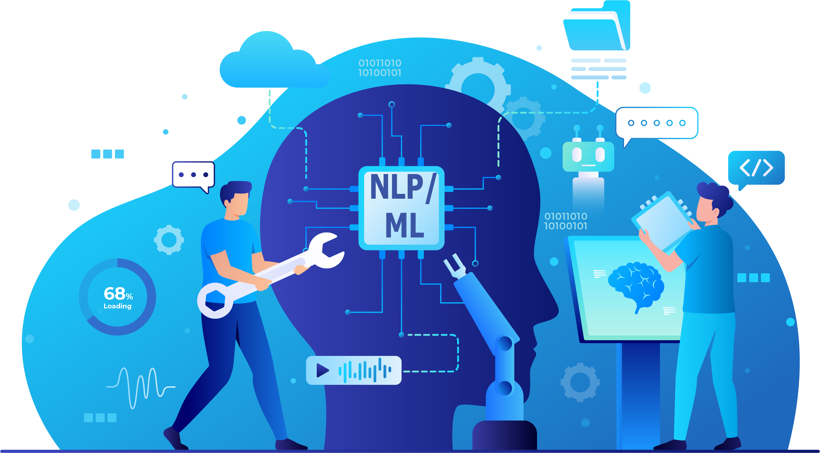
Demand for Cross-disciplinary Skills
What skills may be needed?
Machine Learning:
Machine learning is a subset of AI that enables systems to learn from data and improve their performance.
Understanding machine learning algorithms, such as linear regression, decision trees, neural networks, etc. is essential for developing AI models to do accurate predictions and decisions.
Natural Language Processing:
Skills in processing and understanding human language, including sentiment analysis, language translation, and text summarization.
It is valuable for developing AI applications in areas like chatbots.
Notes:
跨學科技能的需求／強調跨學科技能的重要性

Slide 9
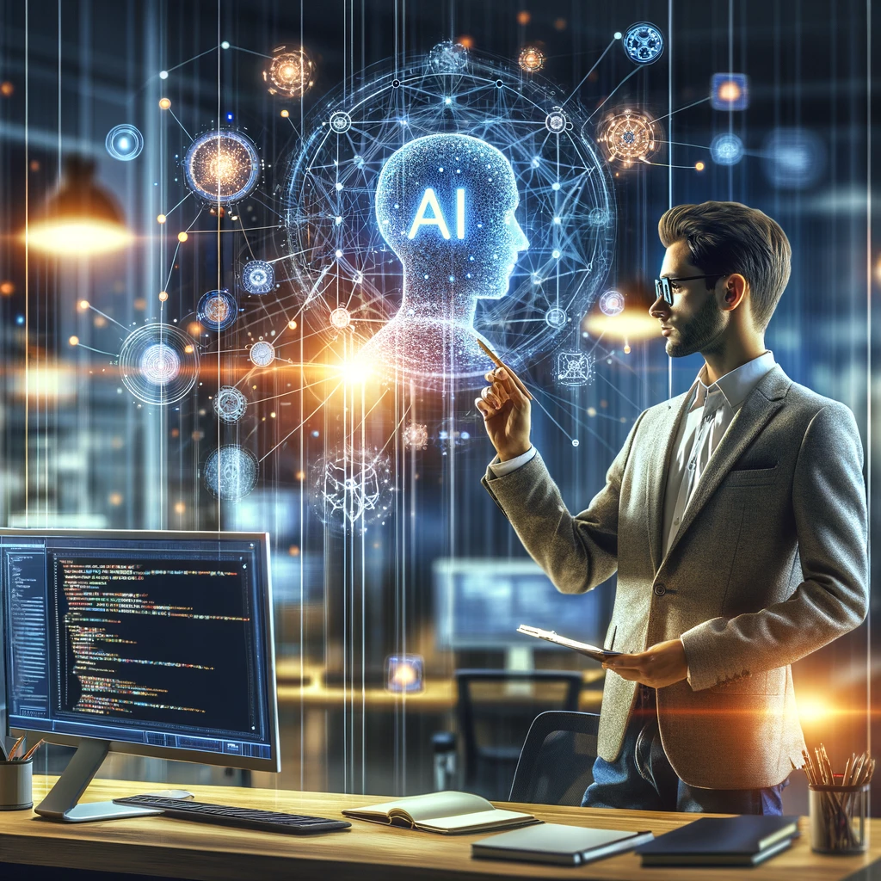
Demand for Cross-disciplinary Skills
Cross-disciplinary Skills
Cross-disciplinary skills play a vital role in the field of Artificial Intelligence, as the application of AI spans multiple domains and professions.
The importance of these interdisciplinary skills is increasingly recognized, as they blend technical knowledge of AI with expertise from other fields to address complex and diverse challenges.
Notes:
跨學科技能的需求／強調跨學科技能的重要性

Slide 10

Demand for Cross-disciplinary Skills
What kind of Cross-Disciplinary Skills may be applied?
Human-Computer Interaction (HCI):
Combining psychology, design, and computer science knowledge to enhance the interaction experience between users and AI systems.
Although HCI draws on design principles from diverse fields, the discipline demands substantial engineering of computing systems.
Business and Market Analysis:
Understanding business processes, market trends, and customer needs to effectively apply AI technologies in business strategies and solutions.
Notes:
跨學科技能的需求／強調跨學科技能的重要性

Slide 11
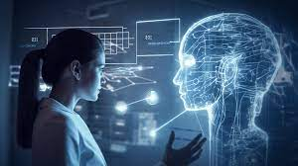
Demand for Cross-disciplinary Skills
What kind of Cross-Disciplinary Skills may be applied?
Project Management and Leadership:
Effectively managing cross-functional teams and projects to ensure the successful implementation and delivery of AI solutions.
Healthcare and Life Sciences:
Applying AI technologies in medical diagnostics, bioinformatics, and drug discovery to enhance healthcare quality and efficiency.
Ethics and Sociology:
Considering the impact of AI in social, cultural, and ethical aspects, especially concerning privacy, bias, and decision transparency.
Notes:
跨學科技能的需求／強調跨學科技能的重要性

Slide 12
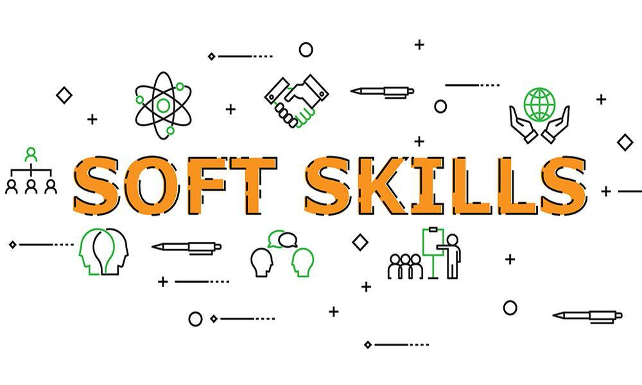

Demand for Cross-disciplinary Skills
What kind of Soft Skills may be applied?
Communication and Team Collaboration Skills:
Effective communication of technical details and project progress, and collaboration within interdisciplinary teams.
Innovative Thinking and Problem-Solving Skills :
Ability to think innovatively and solve complex problems, adapting to the constantly changing technological landscape.
Notes:
跨學科技能的需求／強調跨學科技能的重要性

Slide 13
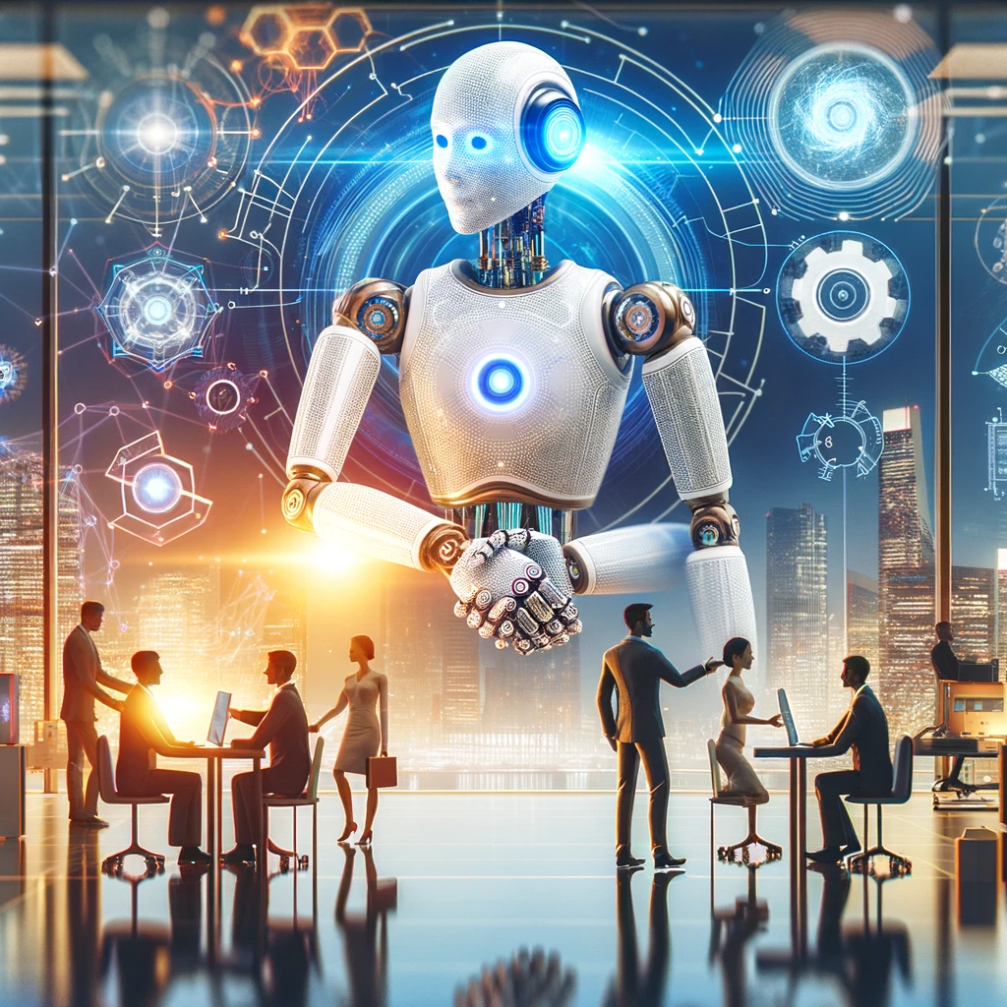
Career Transition
With the widespread application of AI technology across various industries, many professionals are choosing to transition to meet the high demand for AI skills in the market.
Key Points of Career Transition
Skill Education and Training:
Acquiring AI-related skills such as programming, data analysis, machine learning, deep learning, etc.
Participating in relevant courses and training programs, such as online courses, or professional certification.
Notes:
如何實現職業轉型
Prepare for the future: Lifelong Learning, Collaborate with AI, Be flexible and adaptable.

Slide 14

Career Transition
Key Points of Career Transition
Industry Knowledge:
Understanding the application of AI in specific industries (like healthcare, finance, manufacturing, etc.)..
Networking:
Building connections with professionals in the AI field and attending related conferences and seminars.
Career Planning & Continuous Learning:
Plan your career path based on personal interests and expertise.
Given the rapid development of AI technology, continuous learning and updating of knowledge are crucial.
Notes:
如何實現職業轉型

Slide 15

Conclusion & Summary
Acquiring artificial intelligence skills is becoming increasingly important as AI continues to shape our world.
By equipping yourself with the necessary skills, individuals can explore diverse and exciting job opportunities in the field of AI.
Career transition requires not just the acquisition of technical skills but also a deep understanding of new domains and adaptability to change.
It is an ongoing learning process, but it also provides professionals with broad career development opportunities and challenges.
Notes:
如何實現職業轉型

